Slide 1

Text MINING
Dominik Nerger

Slide 2
Overview
1
Introduction
2
3
Data Crawling
4
Implementation
5
Results
6
Conclusion & future work

Slide 3
Overview
1
Introduction
2
3
Data Crawling
4
Implementation
5
Results
6
Conclusion & future work

Slide 4
Introduction
Incorporate concepts from Combinatorial Game Theory (CGT) into an Alpha-Beta solver
Compare performance with Alpha-Beta algorithm

Slide 5
Data set
18 seasons of South Park, 257 episodes
5.27MB, 70879x4 .csv
Crawled from: http://southpark.wikia.com
Worked on own crawl from Wikia, a lot of filtering necessary
Tables change between seasons
Unnecessary information
Provided by: https://github.com/BobAdamsEE/SouthParkData

Slide 6
Preprocessing
Typical pre-processing tasks:
Transformed to lower case
Stripped whitespaces
Removed punctuation, numbers & stopwords
Stemmed document

Slide 7
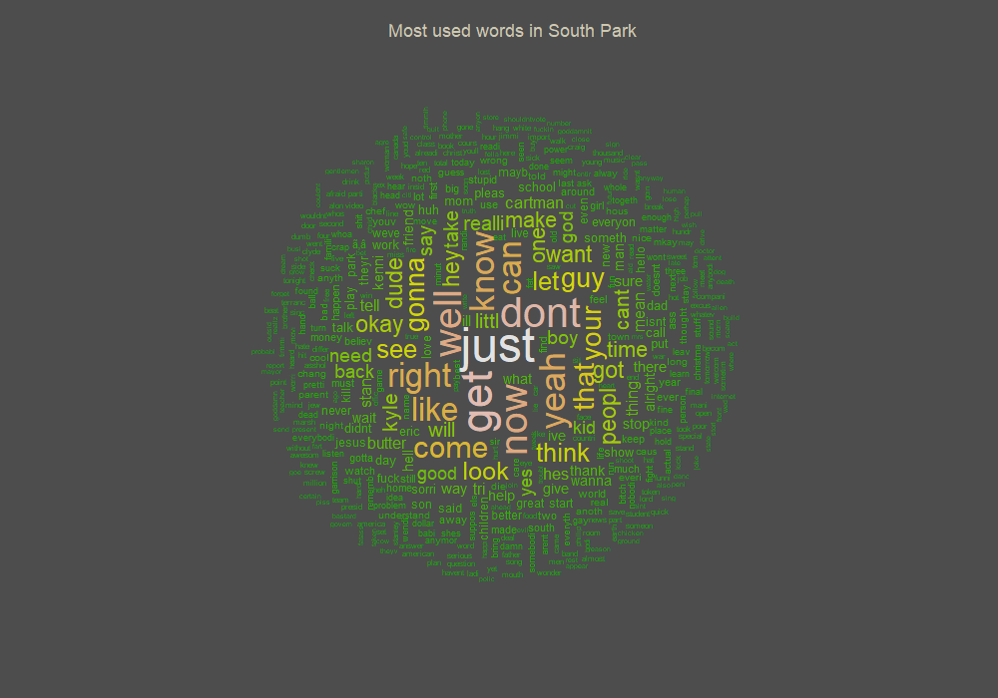
Wordcloud

Slide 8
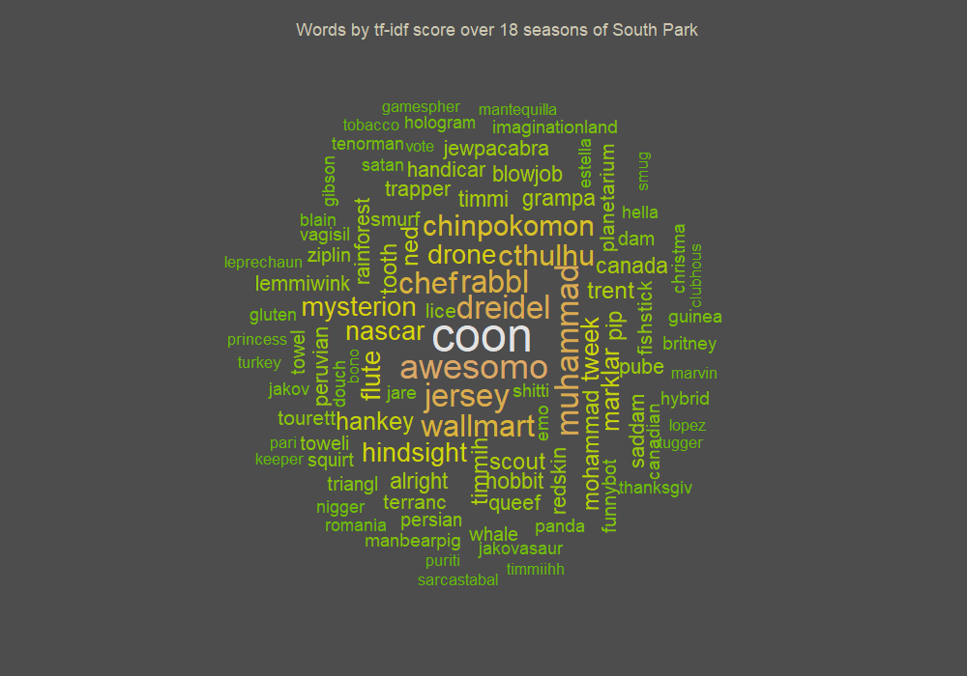
Wordcloud TF-IDF

Slide 9
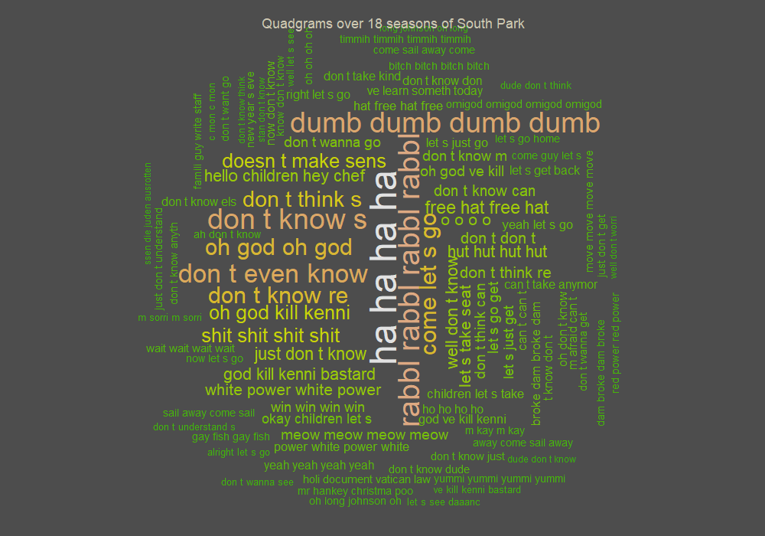
Wordcloud Quadgrams

Slide 10
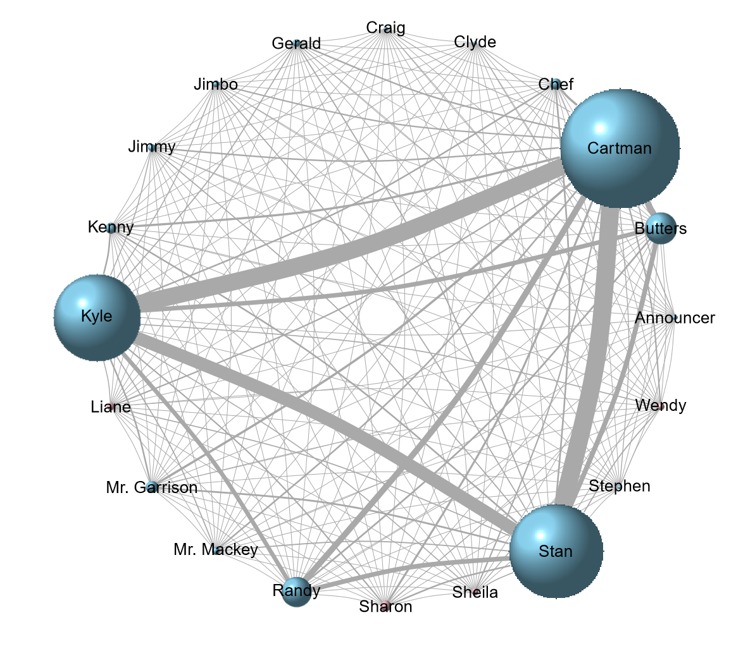
Co-occurence of Characters

Slide 11
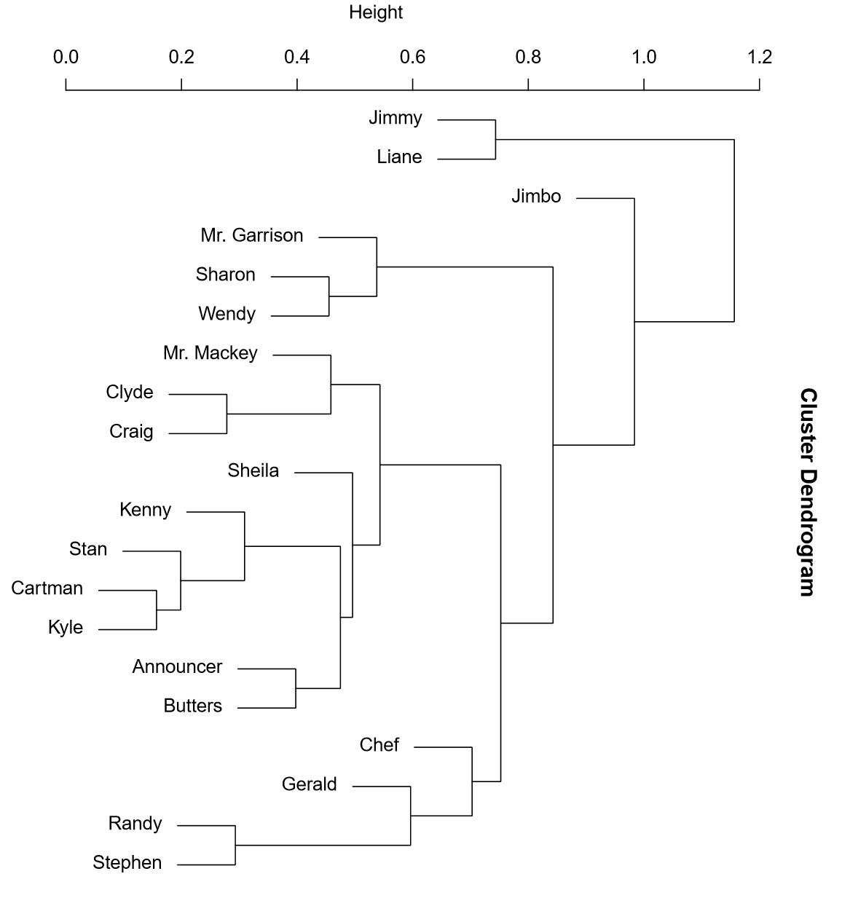
Dendogram

Slide 12
Named Entity Recognition
Compare performance with Alpha-Beta algorithm

Slide 13
Sentiment Mining
Positive/negative sentiment timeline
Aggregation of other sentiments like anger, joy

Slide 14
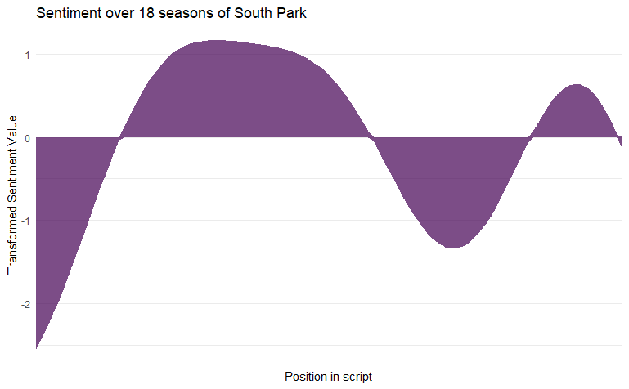
Sentiment Mining

Slide 15
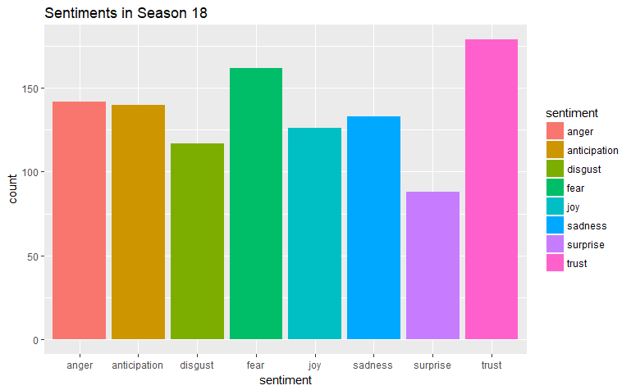
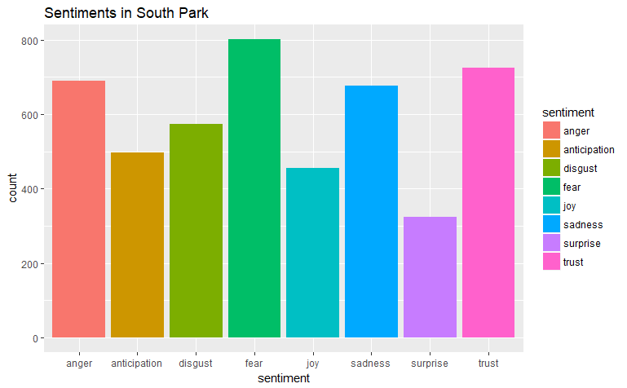
Sentiment Mining

Slide 16
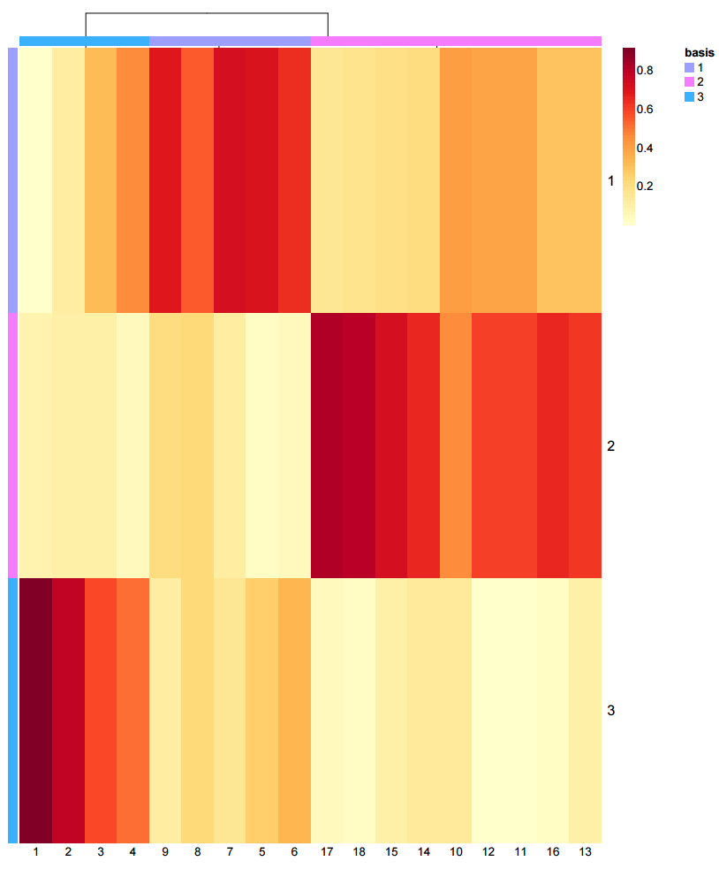
Non-negative Matrix Factorization
Data cluster of related
seasons
18 Seasons, 3 Topics
Clusters:
[1:4]
[5:9]
[10:18]

Slide 17
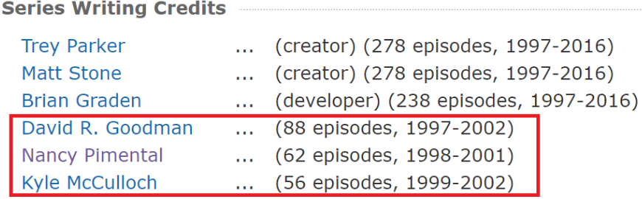
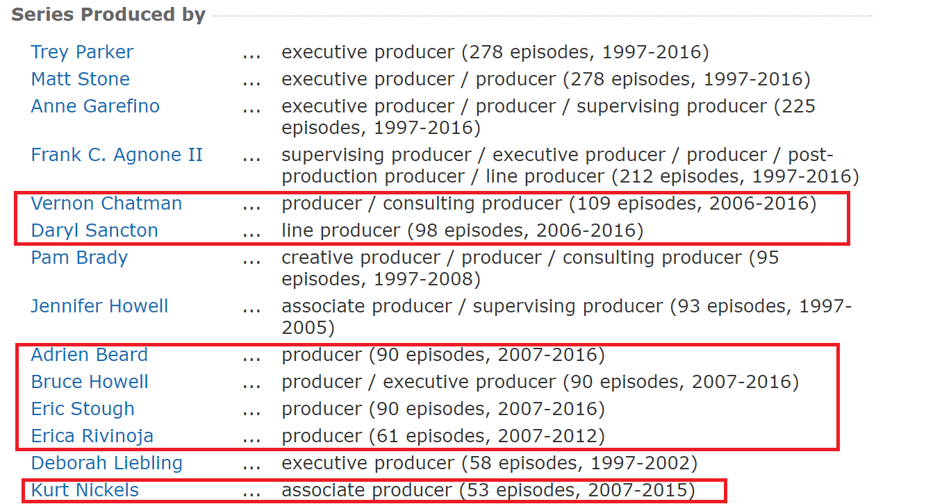
Non-negative Matrix Factorization
Major changes in writing (2001/2002) and producing (2006)
Correlates to different clusters from NMF
Season 5 in 2001
Season 10 in 2006
Conclusion: change of writing style

Slide 18
Combinatorial Games
First player unable to move loses
Alternating moves and finite amount of turns (converging)
No chance involved (deterministic)
Perfect information for both players
No draws

Slide 19
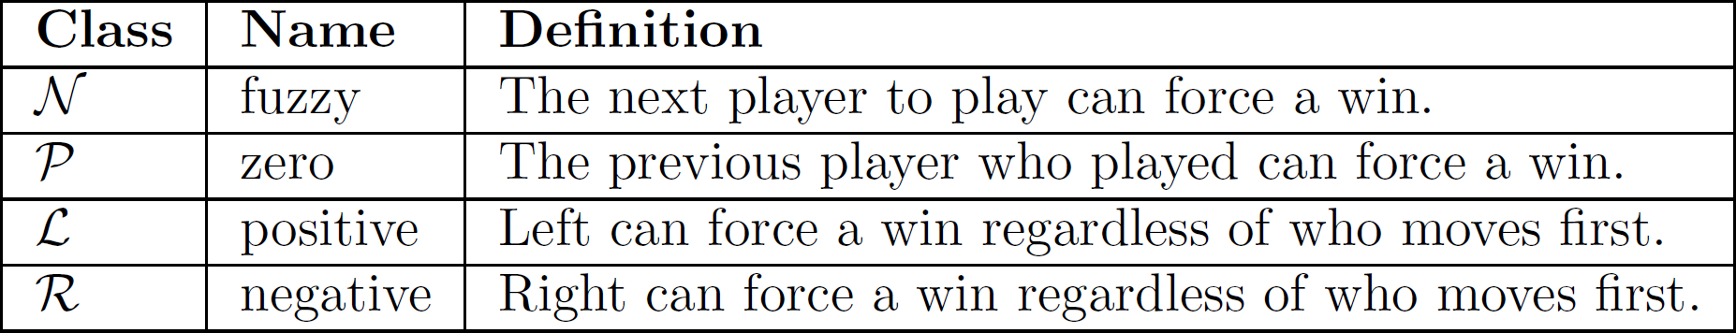
Combinatorial Games
Four outcome classes according to Albert, Nowakowski and Wolfe (2007):

Slide 20
Steps of the project
Analysis
Research
Alpha Beta (AB) Solver
CGT Solver
Combinatorial
AB Solver
Exercise analysis
Learn the game of Konane
Starting research about CGT
Planning of the implemen-tation
Must be adjustet for combinato-rial games
Serves as reference for comparison
Calculcates combinato-rial game values for given positions
Starts with Alpha-Beta search
Uses CGT solver for endgame positions

Slide 21
Overview
1
Introduction
2
3
Data Crawling
4
Implementation
5
Results
6
Conclusion & future work

Slide 22

The game of Konane
Starting position (filled alternating board)

Slide 23

The game of Konane
Remove one piece of each color

Slide 24



The game of Konane
Move by jumping over opponent‘s pieces

Slide 25
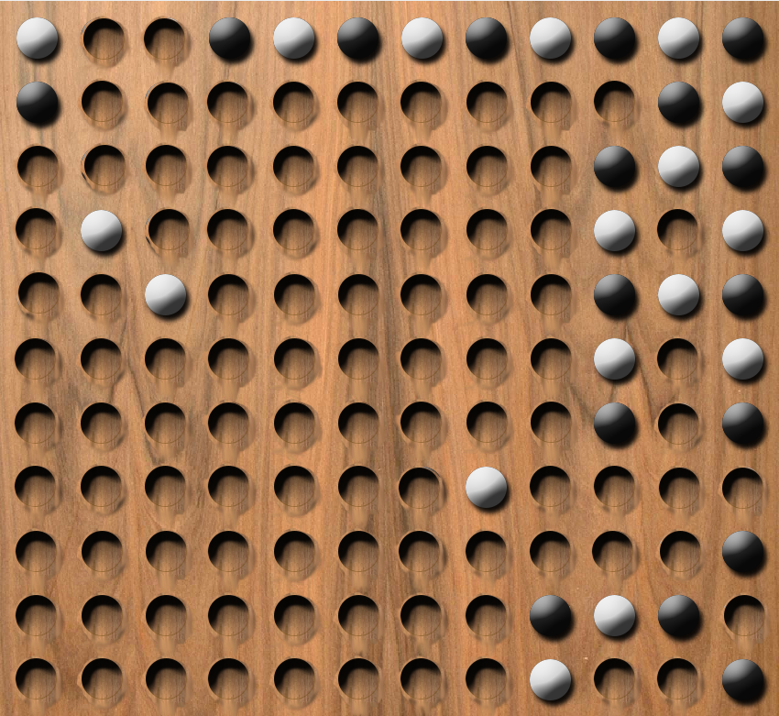
The game of Konane
First player unable to move loses

Slide 26
Overview
1
Introduction
2
3
Data Crawling
4
Implementation
5
Results
6
Conclusion & future work

Slide 27
Research questions
Which changes are necessary in an Alpha-Beta solver to categorize games into one of the four outcome classes?
How can values for game positions be determined?

Slide 28
Research questions
How can an Alpha-Beta solver make use of CGT?
Is pruning in a combinatorial game tree still possible?
Is the approach of combining Alpha-Beta-Search and CGT efficient?

Slide 29
Overview
1
Introduction
2
3
Data Crawling
4
Implementation
4.1
Alpha-Beta solver
4.2
CGT solver
4.3
Combinatorial Alpha-Beta solver
5
Results
6
Conclusion & future work

Slide 30
Implementation
Alpha Beta
CGT Solver
NegaMax
Transposition table
Move ordering
Transposition table
Combinatorial
Alpha Beta Solver
MiniMax
Transposition table
Move ordering

Slide 31
Overview
1
Introduction
2
3
Data Crawling
4
Implementation
4.1
Alpha-Beta solver
4.2
CGT solver
4.3
Combinatorial Alpha-Beta solver
5
Results
6
Conclusion & future work

Slide 32
Alpha-Beta solver
Uses NegaMax, returns -1 (loss) if no moves available
Adjustments:
Game position searched twice
Combine both results to receive outcome class

Slide 33
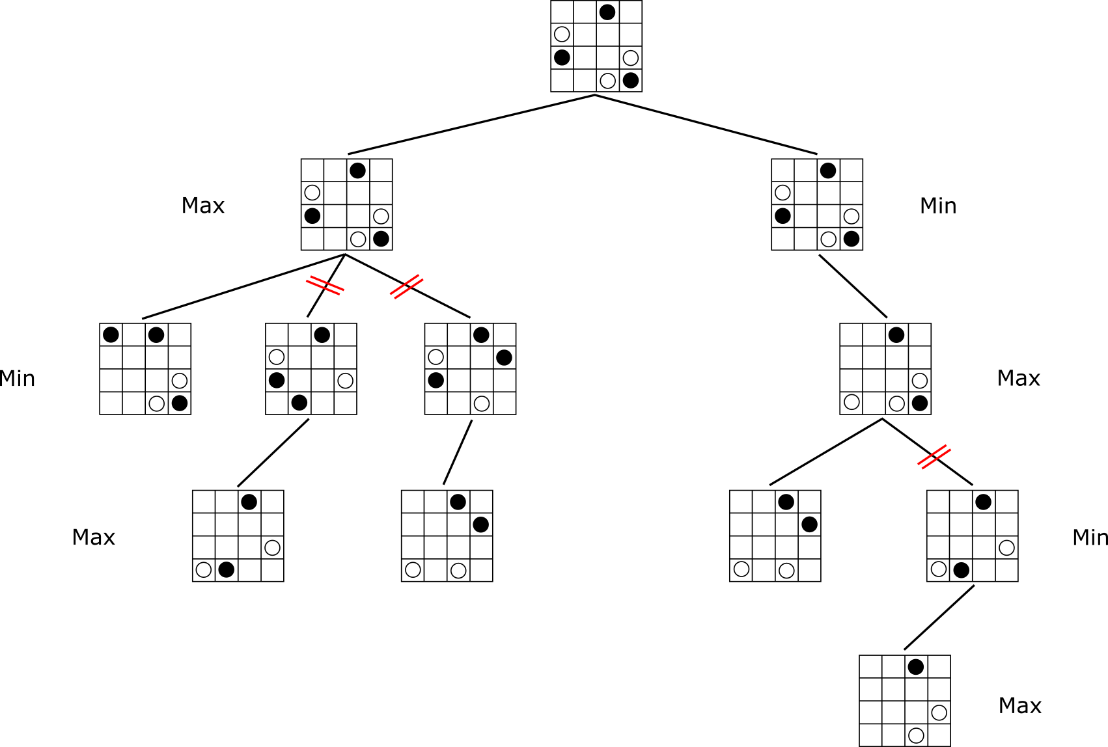
What do we need to change in an Alpha-Beta solver to categorize games into one of the four outcome classes?

Slide 34
Overview
1
Introduction
2
3
Data Crawling
4
Implementation
4.1
Alpha-Beta solver
4.2
CGT solver
4.3
Combinatorial Alpha-Beta solver
5
Results
6
Conclusion & future work

Slide 35
CGT solver
Tries to calculate combinatorial game values for game positions (might be too complex)
Generates all possible moves in every level of the tree
Best option chosen by preference relation

Slide 36
CGT solver
Combines best result for Left and Right
Works with Numbers, Nimbers, Switches, Up and Down

Slide 37
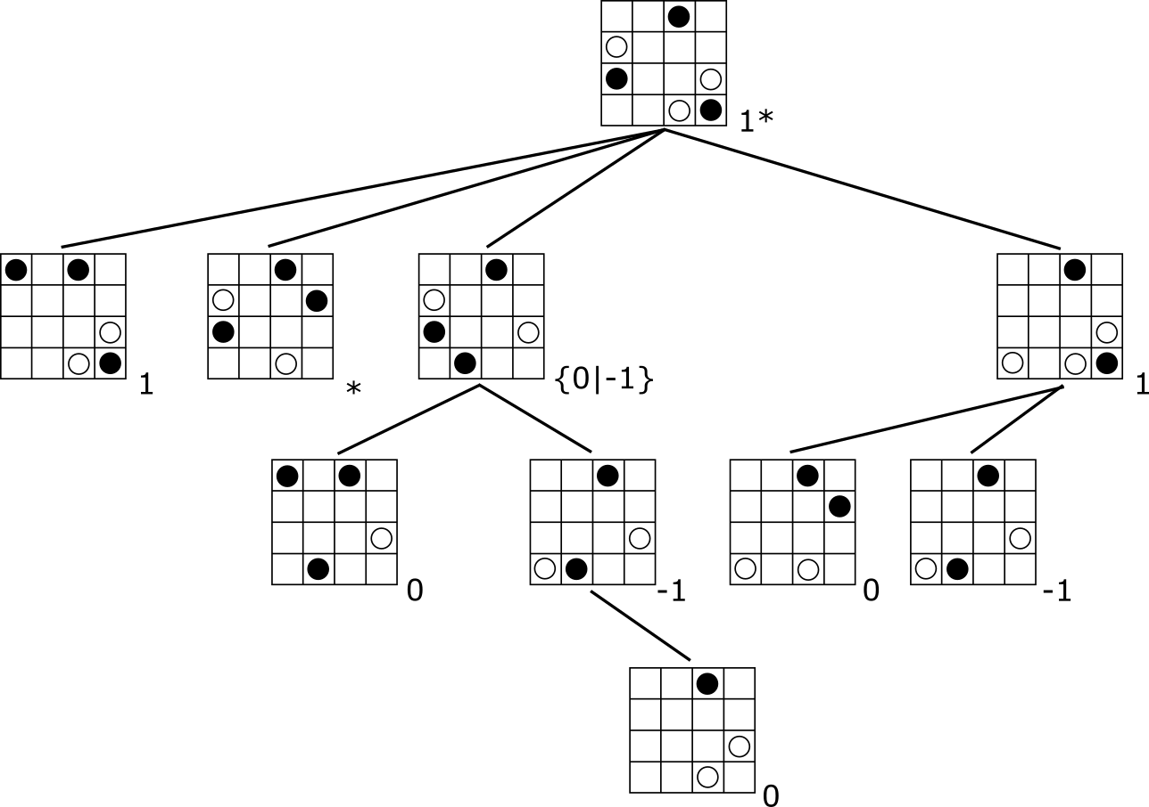
How can we determine values for game positions?

Slide 38
Overview
1
Introduction
2
3
Data Crawling
4
Implementation
4.1
Alpha-Beta solver
4.2
CGT solver
4.3
Combinatorial Alpha-Beta solver
5
Results
6
Conclusion & future work

Slide 39
Combinatorial Alpha-Beta solver
Combines Alpha-Beta and CGT solvers
Alpha-Beta phase followed by CGT phase
CGT solver is evaluation function of Alpha-Beta solver
If combinatorial game values can not be calculated, CAB solver behaves like normal Alpha-Beta
When using 0 and * in Alpha-Beta, 0 must be inverted to * and vice versa when returning

Slide 40
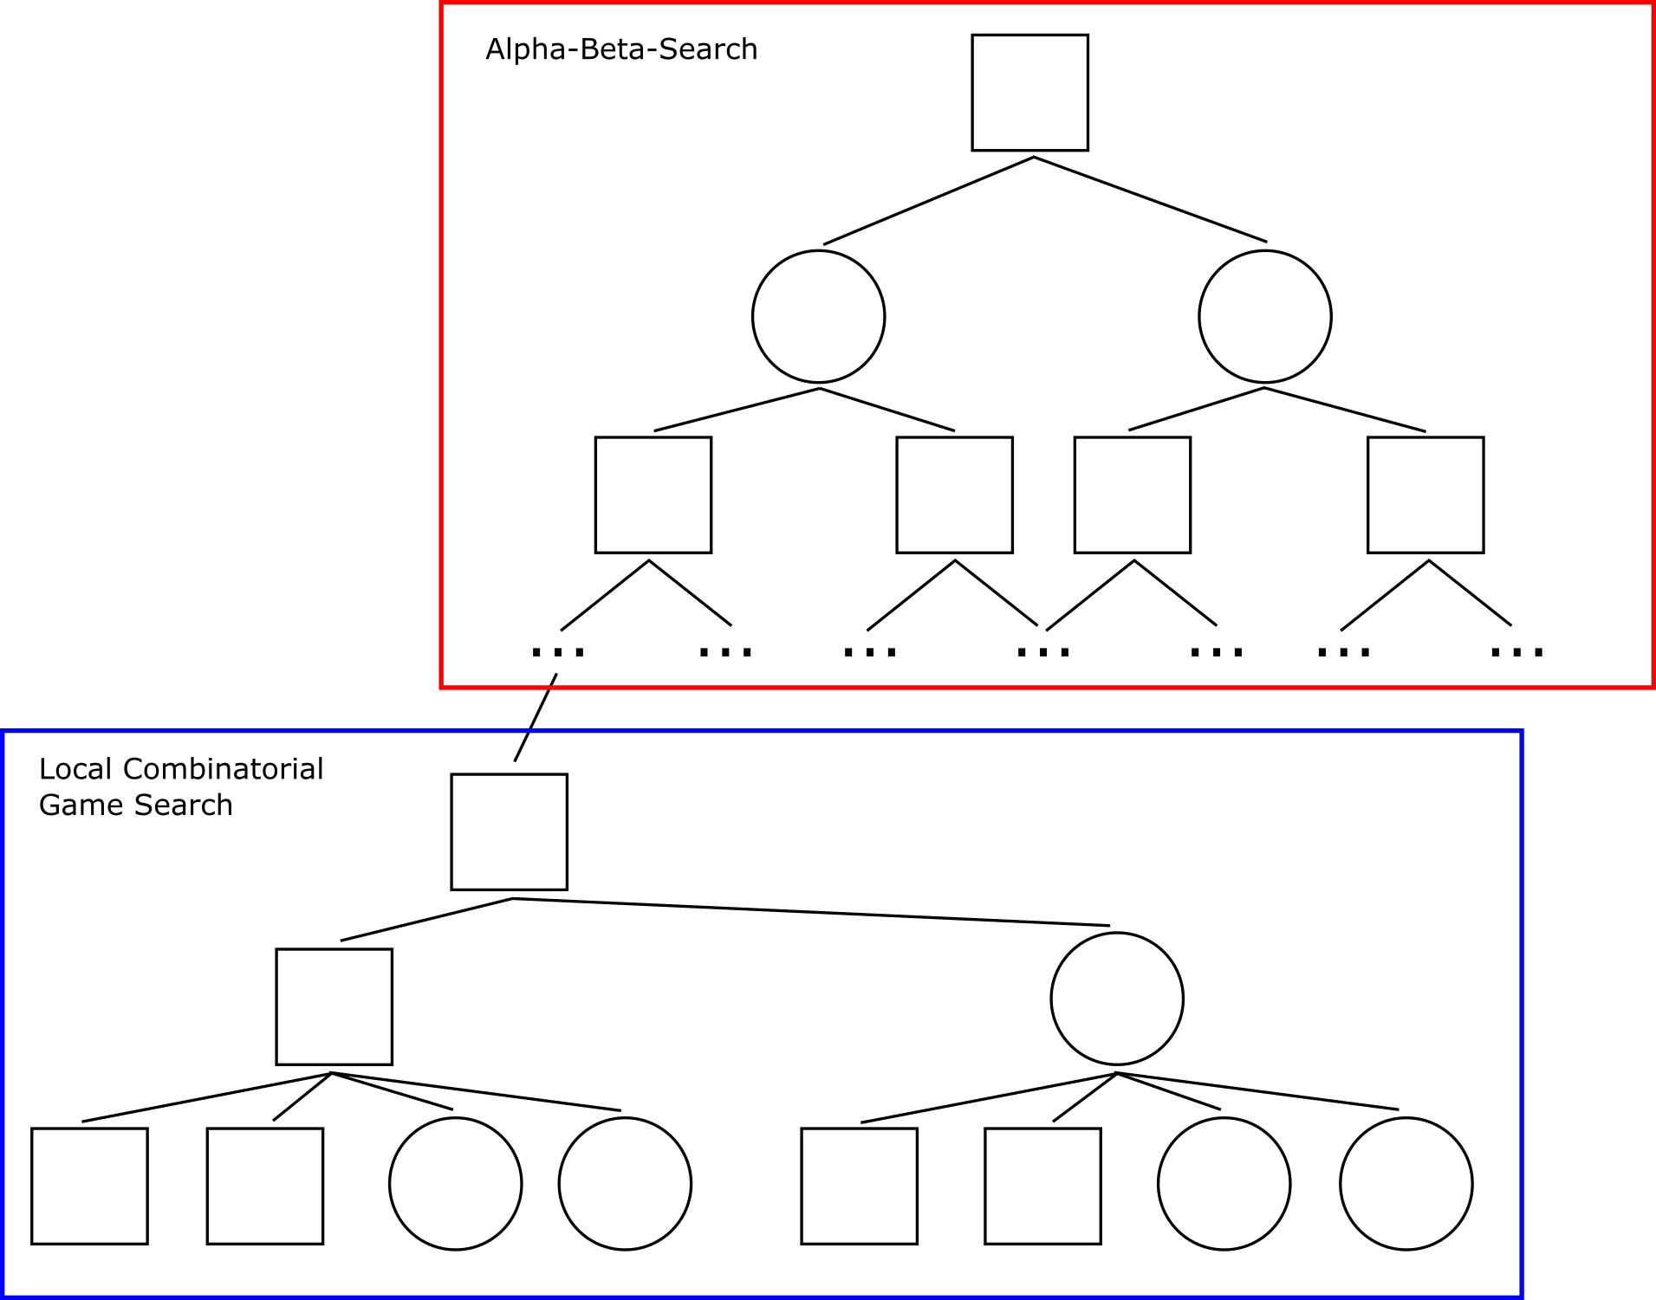
How can an Alpha-Beta solver make use of CGT?

Slide 41
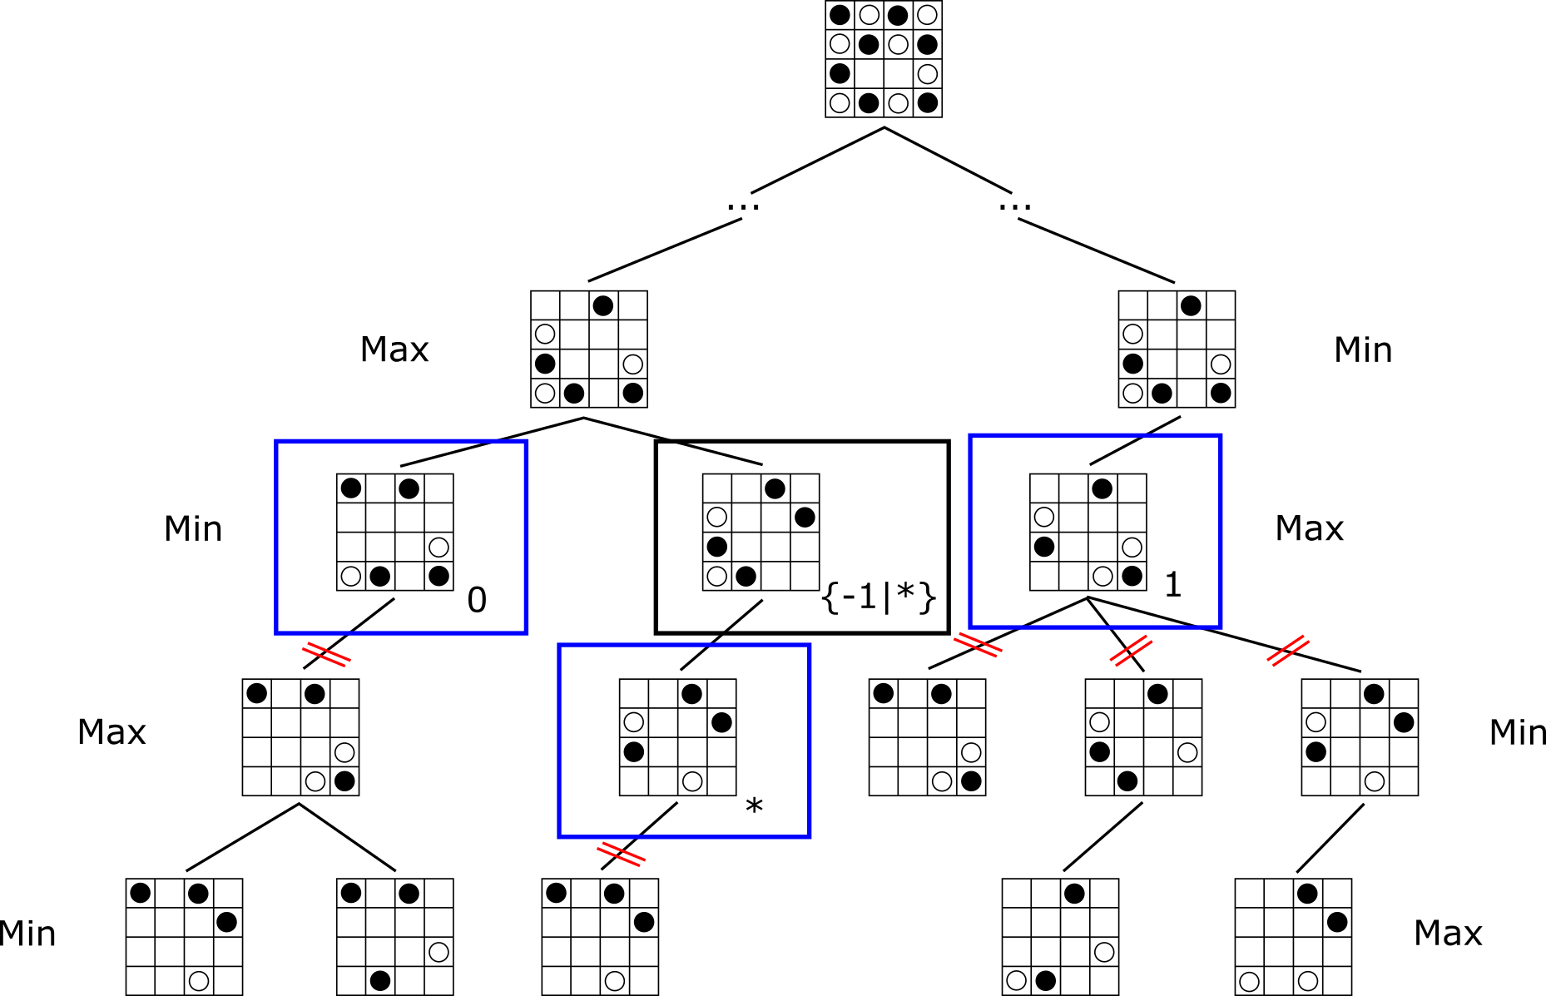
How can an Alpha-Beta solver make use of CGT?

Slide 42
Overview
1
Introduction
2
3
Data Crawling
4
Implementation
5
Results
6
Conclusion & future work

Slide 43
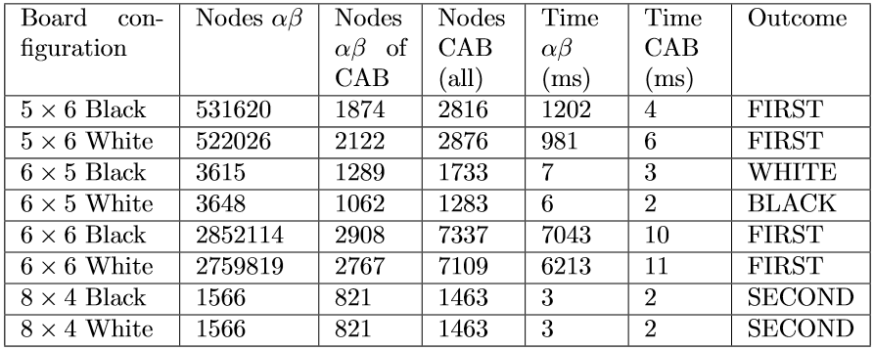
Results

Slide 44
Results
Tested 34 different board configurations
Up to 36 squares
Nodes searched by Alpha-Beta part of CAB smaller than amount searched by Alpha-Beta solver
Doesn‘t search until terminal position
Uses local combinatorial game search, nodes counted separately
Total amount of nodes searched by CAB solver smaller as well

Slide 45
Results
Notes:
Runtime dependent on width

Slide 46
Results
Notes:
Runtime dependent on width

Slide 47
Results
Notes:
Runtime dependent on width

Slide 48
Overview
1
Introduction
2
3
Data Crawling
4
Implementation
5
Results
6
Conclusion & future work

Slide 49
Conclusion
Savings provided by CAB solver justify use of CGT concepts
Usage of CGT is error prone because of many decisions and extra cases
CAB solver is domain independent

Slide 50
Conclusion
No solution whether pruning in combinatorial game trees possible
Might be impossible without losing important information

Slide 51
Future work
Store combinatorial game values in endgame database
Detect subgames and stop Alpha-Beta search phase earlier
Use formulas provided by Ernst to calculate values for certain positions directly

Slide 52

Thank you!

Slide 53
References
Albert, M.H., Nowakowski R. J., & Wolfe, D. (2007). Lessons in play: An introduction to combinatorial game theory
Berlekamp, E. R., Conway, J. H., & Guy, R. K. (1982). Winning ways for your mathematical plays.
Chan, A., & Tsai, A. (2002). 1xn konane: A summary of results. MSRI Publications, 42.
Dos Santos, C. P., & Silva, J.N. (2008). Konane has infinite nim-dimension. Electronical Journal of Combinatorial Number Theory, 8ss.
Ernst, M. D. (1995). Playing konane mathematically: A combinatorial game-theoretic analysis. UMAP Journal
Hern, R. A. (2009). Amazons, konane, and cross purpose are pspace-complete. MSRI Publications, 56.
M. Müller. (1999) Decomposition search: A combinatorial games approach to game tree search, with applications to solving Go endgames. IJCAI-99, volume 1, pages 578-583.

Slide 54
BACKUP

Slide 55
Collaboration in second block
All:
Read into Lessons in Play & Winning Ways
Christoph:
Reimplemented Alpha-Beta solver
Started work on CGT solver
Drew a lot of CGT trees
Found article by Müller about Decomposition Search
Florian:
Reimplemented Transposition Table
Tobias:
Investigated CGSuite
Dominik:
Set up the presentation, read into article by Müller

Slide 56
Schedule for third block
First and second week:
Finish implementation of CGT solver
Aggregation of CGT Values (Arithmetic)
Comparison of games with different outcomes (Numbers, Nimbers, Switches, Infinitesimals)
Third week:
Combine CGT & Alpha-Beta Solver (Decomposition Search)
Gather results of comparison between ABS and DS
Write final report

